Slide 1
INTRODUCTION TO RESEARCH 1.2

Slide 2
INTRODUCTION
Research is a scientific inquiry aimed at learning new facts or testing ideas.
It is the systematic collection , analysis and interpretation of data to generate new knowledge and answer a certain question or solve a problem.
NOTE :
Systematic and orderly (following a series of steps)
Purpose is new knowledge, which must be reliable

Slide 3
METHODOLOGY/RESEARCH METHODS
The ways one collects and analyzes data.
Methods developed for acquiring trustworthy knowledge via reliable and valid procedures.
Methods or Techniques that are used in conducting research.
E.g. Data collection methods, statistical analysis methods.

Slide 4
APPLICATION OF RESEARCH
Important in developing and promoting knowledge and information for innovation
Provides basis for government policies (i.e. Research based decisions)
Provides information that can be used in solving health or social problems

Slide 5
MOTIVATION FOR RESEARCH
Interest to add to the body of knowledge and understanding
To create or develop new/better tools, methods, programs, Equipments
As a means of earning a
Livelihood
Position
Better career
Academic requirement
Governmental directive.

Slide 6
CHARACTERISTICS OF SCIENTIFIC RESEARCH
It demands a clear statement of the problem.
It requires a plan (it is not aimlessly “ looking” for something in the hope that you will come across a solution).
It builds on existing data, using both positive and negative findings.
Determine information already available and what further information is required, as well as the best approach for obtaining it.
New data should be collected as required and be organized in such a way that they answer the research question(s)

Slide 7
TYPES OF RESEARCH
1. Basic vs Applied research
Basic research
Also called fundamental research.
Carried out to determine or establish fundamental facts and relationships within a discipline or field of study. Develop theories eg Mathematics, Physical sciences, Biological sciences.
Generate new knowledge and technologies to deal with major unresolved health problems.
Has little application to policy and management but could be done to guide applied research.

Slide 8
Continuation of types of Research…
2. Applied research
undertaken specifically for the purpose of obtaining information to help resolve an immediate problem facing the society or organization.
is necessary to identify priority problems and to design and evaluate policies and programs that will deliver the greatest health benefit, making optimal use of available resources.
Concerned with “How much” “How many” “How often” “To what extend”

Slide 9
2. Quantitative vs Qualitative research
(a) Quantitative Research
Generates numerical data or information that can be converted into numbers.
Information that can be expressed in terms of quantity or amounts.
It is used to describe variables.
Examine relationships among variables.
Determine cause-effect interactions between variables.

Slide 10
(b). Qualitative research
Concerned with developing explanations of social phenomena.
Deals with phenomena relating to or involving quality or kind.
Important in behavioral sciences.
seeks to answer questions about:
Why people behave the way they do
How opinions and attitudes are formed
How and why cultures have developed in the way they have
Qualitative research is concerned with finding the answers to questions which begin with: why? How? In what way? Underlying motive of human behavior

Slide 11
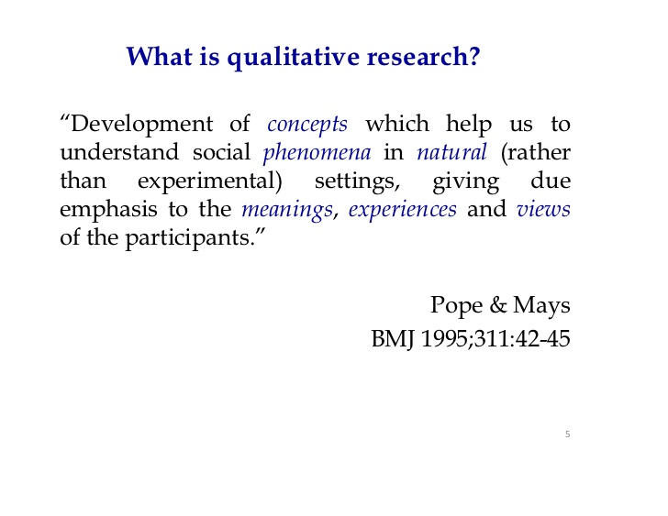
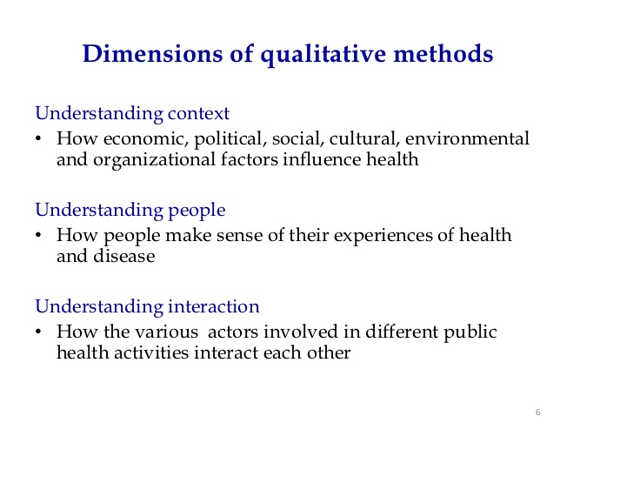
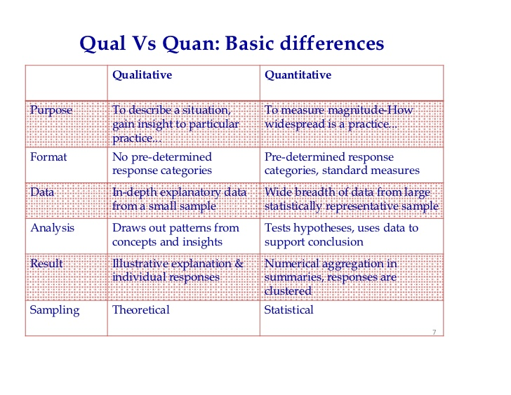
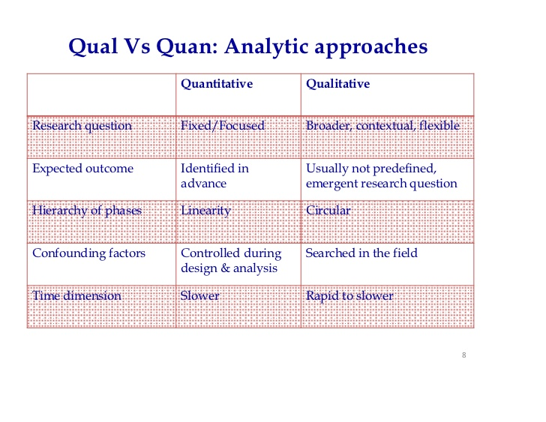

Slide 12
3.Descriptive vs Analytical Research
Descriptive Research :
the attempt to determine, describe, or identify characteristics of individuals or situations.
Focus on the state of affairs as it exists at present.
Researcher has no control over variables and can only report what has happened or is happening.
Generates hypothesis

Slide 13
(b) Analytical Research :
Researcher uses facts or information already available and analyzes these to make a critical evaluation of the materials.
Applicable in All disciplines.
Test hypothesis.

Slide 14
4. Conceptual vs Empirical Research
(a) Conceptual Research
Research is about abstract ideas or theory.
Commonly used by philosophers to develop new concepts or re-interpret existing ones
E.g.: Attack from ghosts
(b) Empirical Research
Also called experimental research
Research is data-based and subject to verification
Leads to conclusions that can be verified by observation or experiments

Slide 15
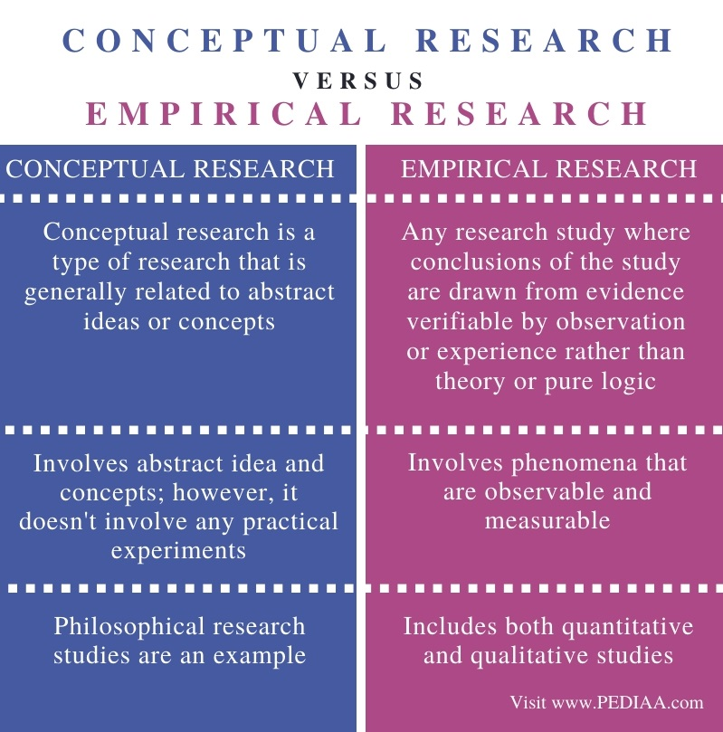

Slide 16
5. FIELD-BASED vs LABORATORY RESEARCH
(a) Field based Research
Carried out among the population
Data collected by observation or measurements
(b) Laboratory Research
Involves carrying out experiments in the laboratory
Data collected by measurements or observation

Slide 17
6. Clinical Research
Focuses on studies of prevention and diagnosis through new methods of treatment, Care or rehabilitation.
Examples” Clinical trials, Design of new chemotherapeutic agent

Slide 18
END
THANK YOU

